Slide 1

CENTRAL UNIVERSITY OF RAJASTHAN
Department of Computer Science
Dissertation (CSC-413)
Health Insurance Cost Prediction using Machine Learning
SUBMITTED BY:
AADESH NATH YOGI 2022MSCS001
SUPERVISED BY:
DR. MAMTA RANI
(professor)

Slide 2
INDEX
INTRODUCTION
PROBLEM STATEMENT
DATASET OVERVIEW
IMPLEMENT
METHODOOGY USED
RESULTS AND DISCUSSION
CONCLUSION
FUTURE WORK

Slide 3


INTRODUCTION
[1.]
This paper represents a machine learning-based health insurance prediction system.
Recently, many attempts have been made to solve this problem, as after Covid-19 pandemic, health insurance has become one of the most prominent areas of research.
People’s healthcare cost forecasting is a valuable tool for improving healthcare accountability

Slide 4
PROBLEM STATEMENT
[1.]
A health insurance company can only make money if it collects more than it spends on the medical care of its beneficiaries.
medical costs are difficult to predict since most money comes from rare conditions of the patients
The objective of this article is to accurately predict insurance costs based on people’s data, including age, Body Mass Index, smoking or not, etc.

Slide 5
DATASET DESCRIPTION
[2.]
Data taken from kaggle link provided in the link
The detail of each column is given in table
And some characteristics of dataset used
Name of variables ,and type , details(age, BMI, area, children, insurance charges, gender)
FEATURES IN DATA SET
Age
Gender
BMI
Smoking Habit
Area
Convert the data of the categorical
columns into numerical data

Slide 6
[2.]
Variable | Sub-Variable | Data type
Gender | Male [0], Female [1] | obj
Age |  | int
BMI |  | flot
Region | SE(0), SW(1), NE(2), NW(3) | obj
Smoker | Yes(1), No(0) | obj
Childern |  | int
Charge |  | flot
Dataset link ;- Health Insurance Cost Prediction (kaggle.com)

Slide 7
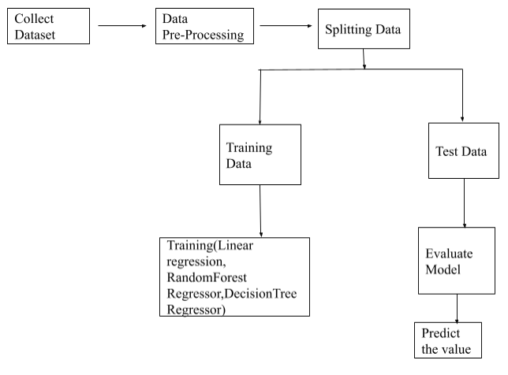
METHODOLOGY
[2.]

Slide 8
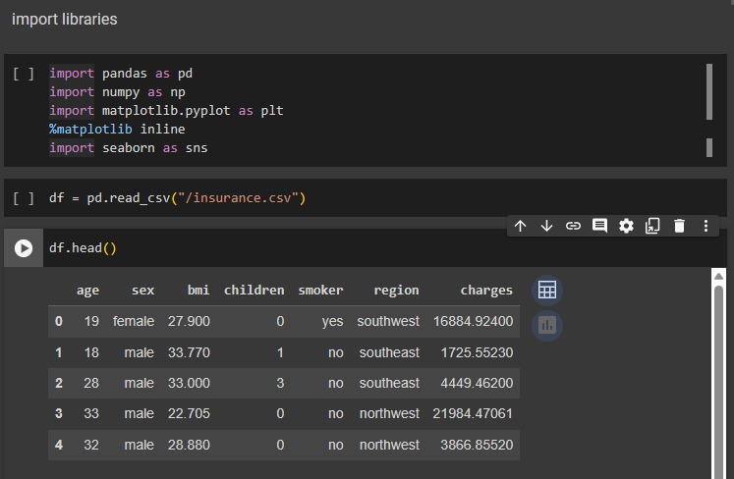
Implement the processing
[2.], [4.]
PROGRAM CODE
Importing libraries
Importing Datasets
Data Collection & Analysis

Slide 9
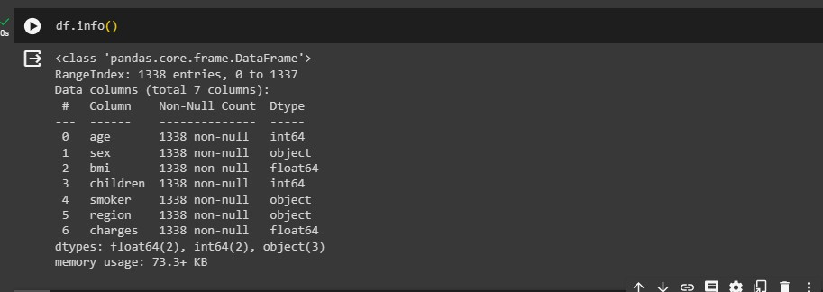
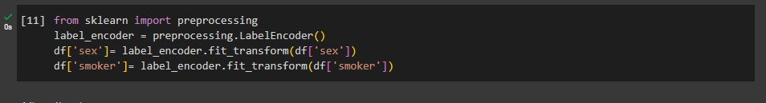
Convert columns from string (‘sex’,’smoker’,’region’) to numerical values and check null values
Data Pre-Processing
Splitting the Features and Target

Slide 10
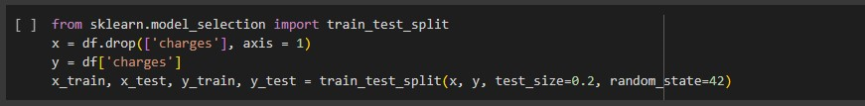
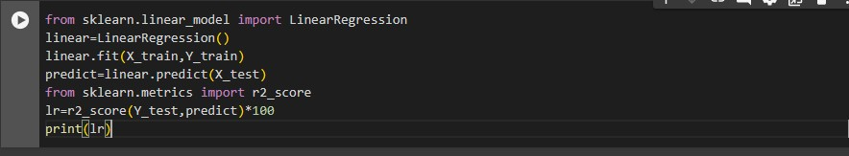
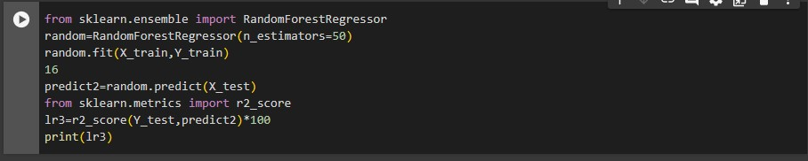
Splitting the data into Training data & Testing Data
Model Training by two algo.
Predicting the charge
Link on colab notebook ;- https://colab.research.google.com/ drive/1zL7MO936yPbKgTUO_Dl73imY4mQgdrRT?usp=sharing

Slide 11
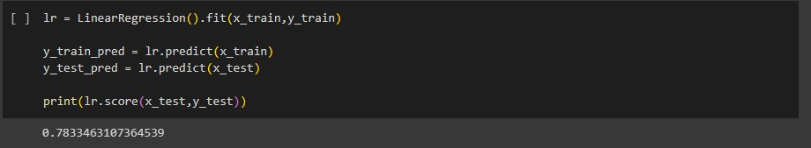
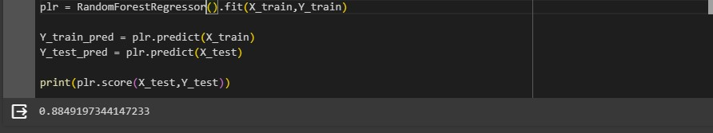
Accuracy prediction for both algorithm
Algorithms | Accuracy
Linear regression | 78%
Decision tree | 88%

Slide 12
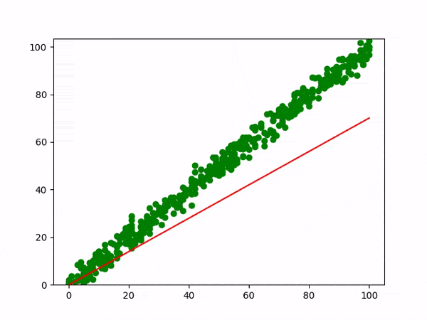
linear regression
[2.]
Linear regression, in statistics, a process for determining a line that best represents the general trend of a data set
Simple Linear Regression
Multiple Linear Regression

Slide 13
Decision Tree Algorithms
[2.]
that can be used for both classification and regression tasks.
These rules can then be used to predict the value of the target variable for new data samples.
Components of a Decision Tree
Root Node, Internal Node, Leaf/Terminal Node, Parent Node, Child Node
At the heart of decision trees lie two fundamental metrics: entropy and Gini impurity.

Slide 14
Mathematically, entropy is calculated using the formula:
Information Gain
Gini Impurity
ID3, CART

Slide 15
References
[1.]
Painuli D, Mishra D, Bhardwaj S, Aggarwal M. Forecast and prediction of COVID-19 using machine learning. Data Science for COVID-19. 2021:381–97. doi: 10.1016/B978-0-12-824536-1.00027-7. Epub 2021 May 21. PMCID: PMC8138040.
K. Bhatia, S. S. Gill, N. Kamboj, M. Kumar and R. K. Bhatia, "Health Insurance Cost Prediction using Machine Learning," 2022 3rd International Conference for Emerging Technology (INCET), Belgaum, India, 2022, pp. 1-5, doi: 10.1109/INCET54531.2022.9824201.
Kaggle for dataset
Colab G-drive for code implement
[2.]
[3.]
[4.]

Slide 16
FUTURE work using the different algorithms in insurance cost prediction and comparision of different algorithms
THANK YOU

